Slide 1
Early Termination of Convex QP Solvers in Mixed-Integer Model Predictive Control for Real-Time Decision Making
J. Liang (Georgia Tech, MERL intern), S. Di Cairano, R. Quirynen
American Control Conference May 25-28, 2021, Virtual
Notes:
Hello everyone, my name is Jiaming Liang and I’m a fourth year PhD student in Operations Research from Georgia Tech. Today I’m going to talk about Early Termination of Convex QP Solvers in Mixed-Integer Model Predictive Control for Real-Time Decision Making
This is a work done during my internship at Mitsubishi electric research with my mentors Stefano Di Cairano and Rien Quirynen from MERL.

Slide 2
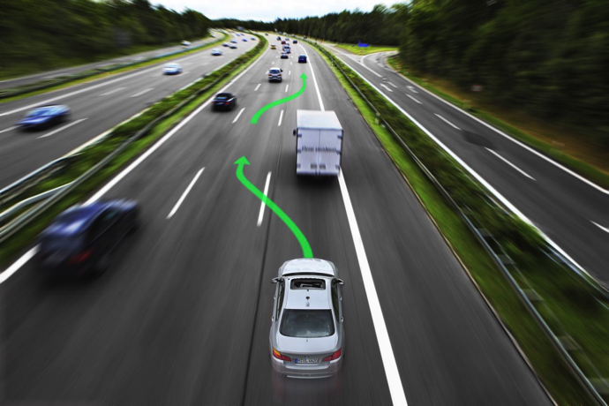
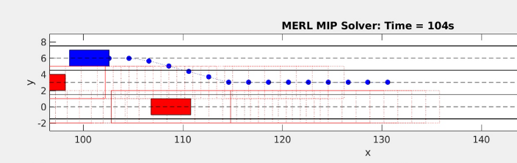
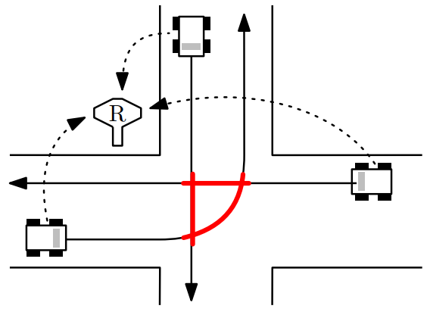
Mixed-Integer MPC for Real-Time Decision Making
Switches in system dynamics, e.g., contacts
Discrete decisions, e.g., pass or stay in lane
Quantized decisions, e.g., on/off actuation
Disjoint constraint sets, e.g., obstacle avoidance
Mixed-integer quadratic programming (MIQP) can be used for MPC of systems with linear/piecewise-linear dynamics and with both continuous and discrete decisions, e.g., lane selection and continuous trajectory within the lane
Notes:
MI-MPC provides a general-purpose modeling framework for real-time decision making.
In this work, we are particularly interested in an MI-MPC formulation of a high-level motion planning task for an autonomous vehicle, including discrete decisions resulting from lane changes, static and dynamic obstacles
The MI-MPC framework solves an MIQP problem at every sampling time instant.

Slide 3
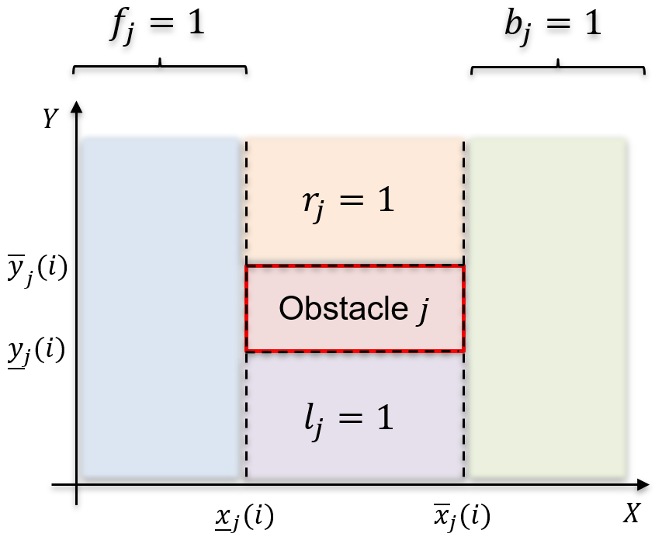
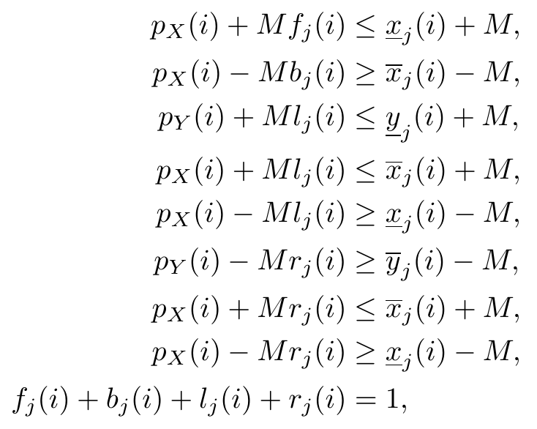
Mixed-Integer MPC for Real-Time Decision Making (cont.)
Switches in system dynamics, e.g., contacts
Discrete decisions, e.g., pass or stay in lane
Quantized decisions, e.g., on/off actuation
Disjoint constraint sets, e.g., obstacle avoidance
For example, using big-M formulation and 4 binary variables:
Notes:
MIQP formulation consists of quadratic objective function + constraints involving continuous and integer variables describing vehicle dynamics and constraints for obstacle avoidance
For example, one can use 4 binary variables denoting the position of the vehicle w.r.t. the obstacle and the big M method to describe the obstacle avoidance constraints

Slide 4
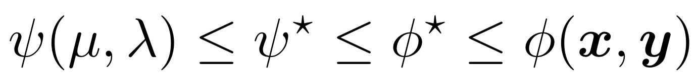

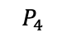
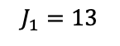
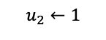
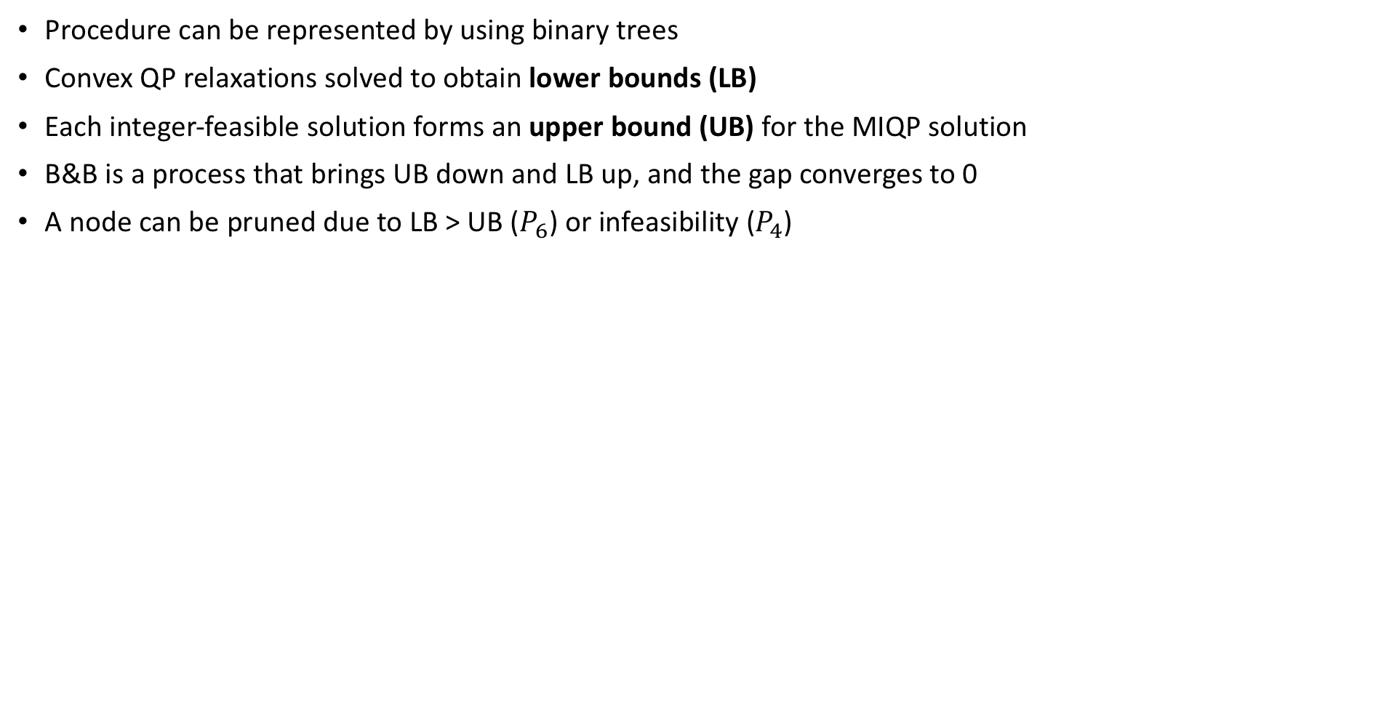
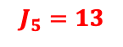

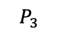
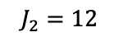
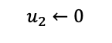
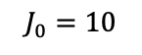
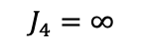
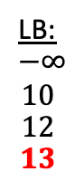

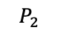
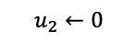

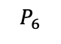
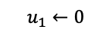
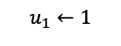
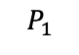
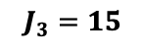
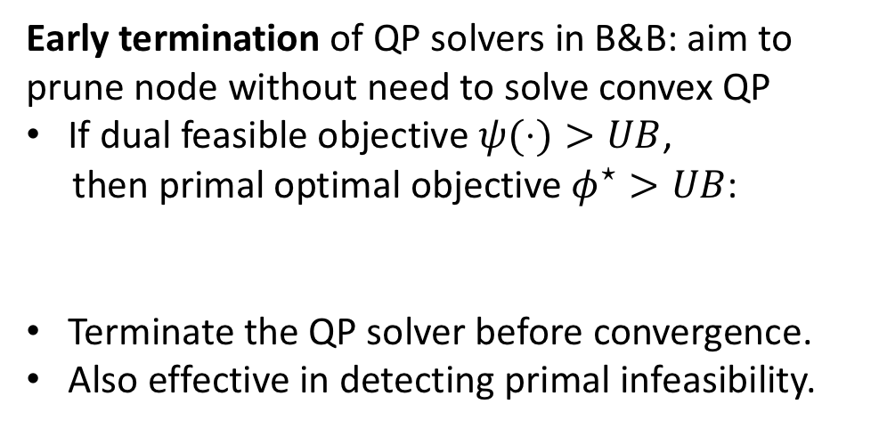

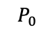
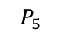
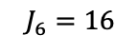
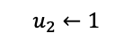
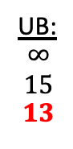
Branch-and-Bound Algorithm for MIQP
$$P_{0}$$
Procedure can be represented by using binary trees
Convex QP relaxations solved to obtain lower bounds (LB)
Each integer-feasible solution forms an upper bound (UB) for the MIQP solution
B&B is a process that brings UB down and LB up, and the gap converges to 0
A node can be pruned due to LB > UB ($P_{6}$) or infeasibility ($P_{4}$)
$$P_{1}$$
$$P_{2}$$
$$P_{3}$$
$$P_{4}$$
LB:
$$−∞$$
$$10$$
$$12$$
$$13$$
UB:
$$∞$$
$$15$$
$$13$$
$$J_{0}=10$$
Early termination of QP solvers in B&B: aim to prune node without need to solve convex QP
If dual feasible objective $ψ(⋅)>UB$,
then primal optimal objective $φ^{⋆}>UB$:
Terminate the QP solver before convergence.
Also effective in detecting primal infeasibility.
$$P_{0}$$
$$u_{1}←0$$
$$u_{1}←1$$
$$J_{1}=13$$
$$P_{1}$$
$$P_{2}$$
$$J_{2}=12$$
$$u_{2}←0$$
$$u_{2}←1$$
$$u_{2}←0$$
$$u_{2}←1$$
$$P_{3}$$
$$P_{4}$$
$$P_{5}$$
$$P_{6}$$
$$J_{3}=15$$
$$J_{4}=∞$$
$$J_{5}=13$$
$$J_{6}=16$$
Notes:
In order to solve MIQPs to global optimality, most algorithms are based on a variant of the branch-and-bound (B&B) method
Worst case: need to solve exponentially many convex (QP) relaxation problems, would be very time consuming
Goal: terminate the nodes that would not give us optimal solutions as early as possible and move onto other nodes
our contribution in this work is that we proposed an early termination strategy that can prune the nodes without the need to solve convex QPs to convergence,
in addition, this strategy is also effective in infeasibility detection

Slide 5
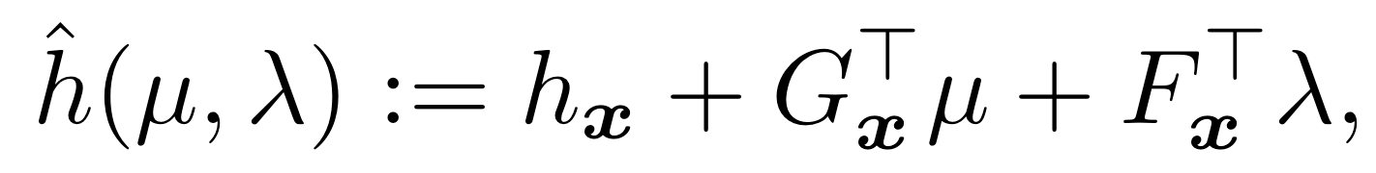
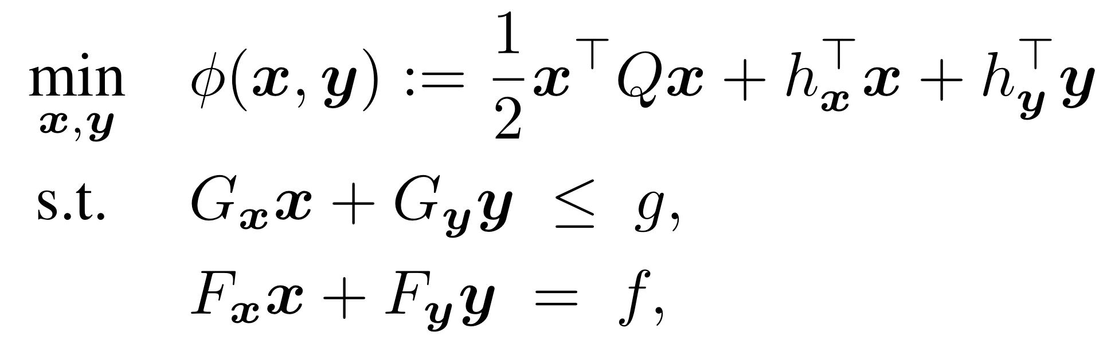
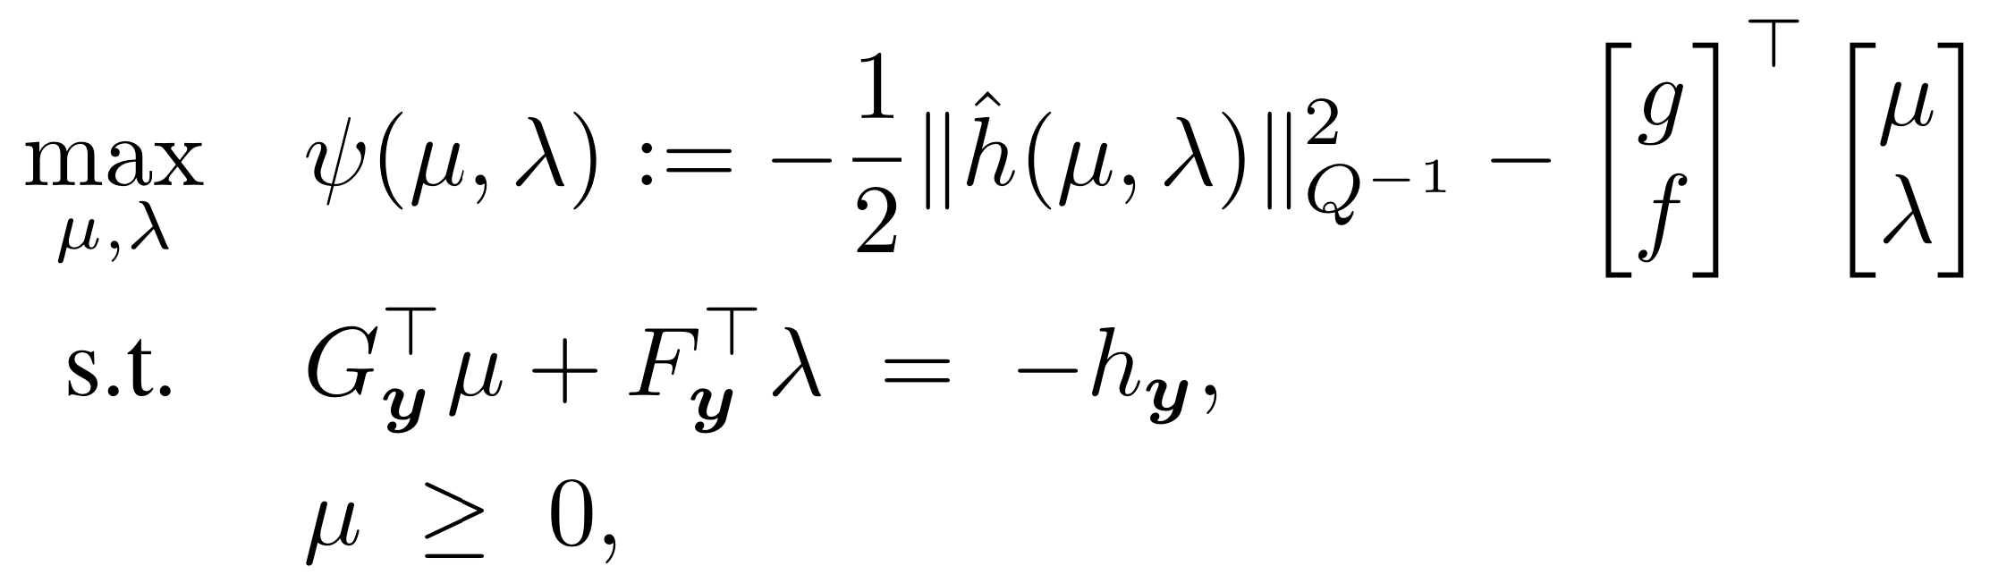
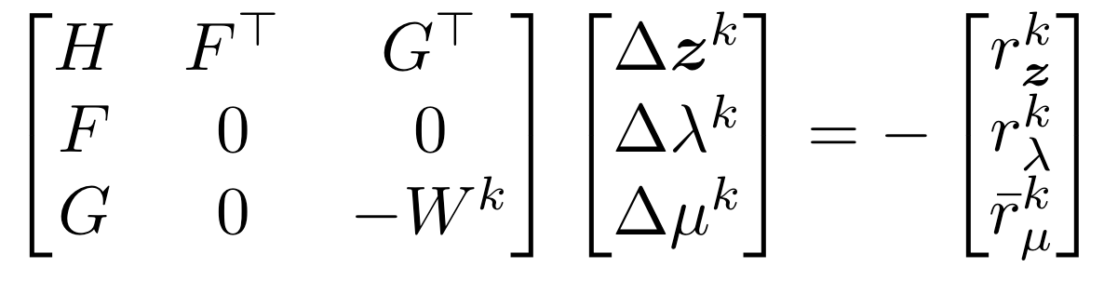
QP Formulations and Infeasible IPM Solver
Primal QP Formulation
Dual QP Formulation
Infeasible IPM: Newton-type iteration
Problem: infeasible IPM iterations generally do not satisfy dual feasibility until convergence Proposed solution: computationally efficient projection to obtain dual feasible solution guess for early termination of infeasible IPMs
Notes:
Problem at each node: QP relaxation, solver: infeasible IPM
Decompose the decision variables into x and y, Q is positive definite
Dual formulation with Q inverse

Slide 6
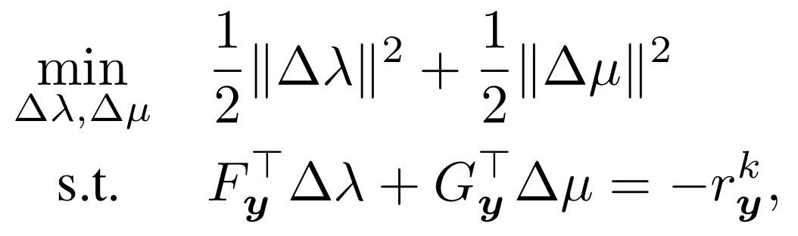
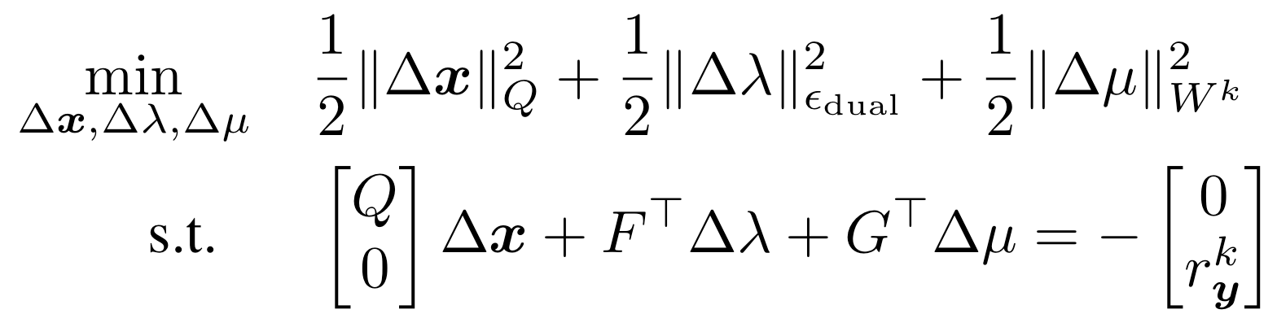
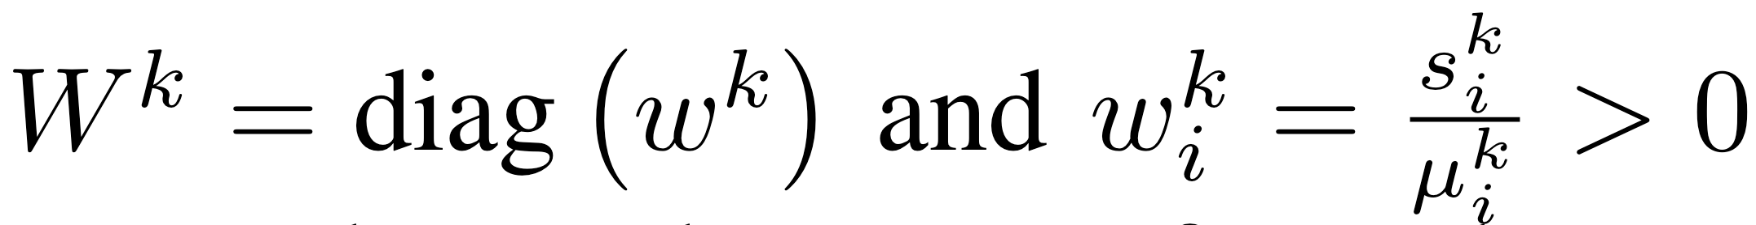
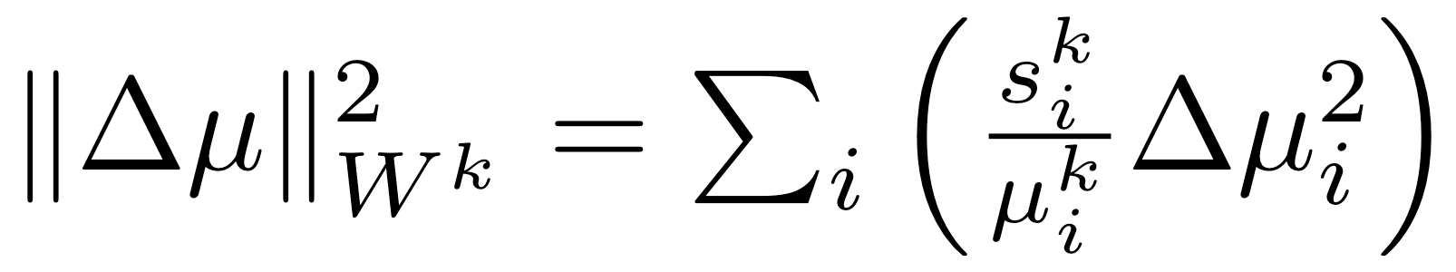
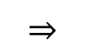
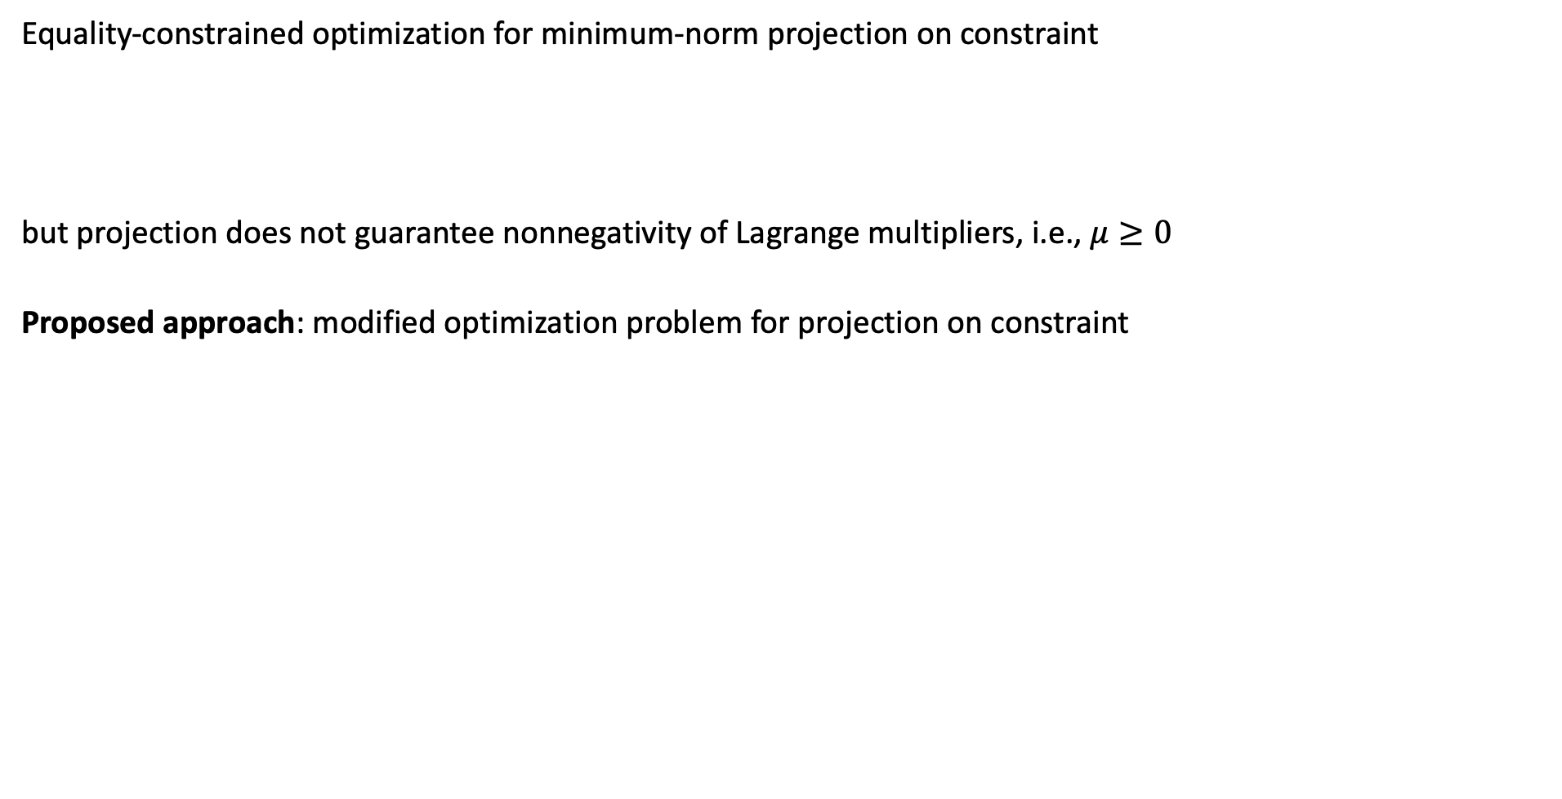
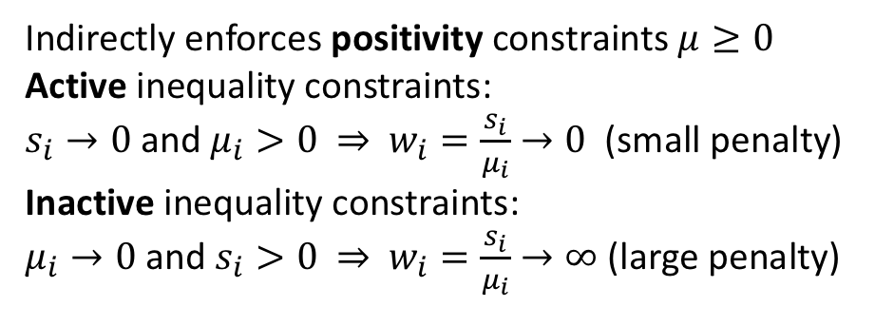
Infeasible IPM: Projection to Dual Feasibility
Equality-constrained optimization for minimum-norm projection on constraint
but projection does not guarantee nonnegativity of Lagrange multipliers, i.e., $μ≥0$
Proposed approach: modified optimization problem for projection on constraint
Indirectly enforces positivity constraints $μ≥0$ Active inequality constraints:
$s_{i}→0$ and $μ_{i}>0$ $⇒$ $w_{i}=\frac{s_{i}}{μ_{i}}→0$ (small penalty)
Inactive inequality constraints:
$μ_{i}→0$ and $s_{i}>0$ $⇒$ $w_{i}=\frac{s_{i}}{μ_{i}}→∞$ (large penalty)
$$⇒$$
Notes:
A standard minimum-norm projection
Recall dual feasibility=equality constraint + nonnegativity of \mu

Slide 7
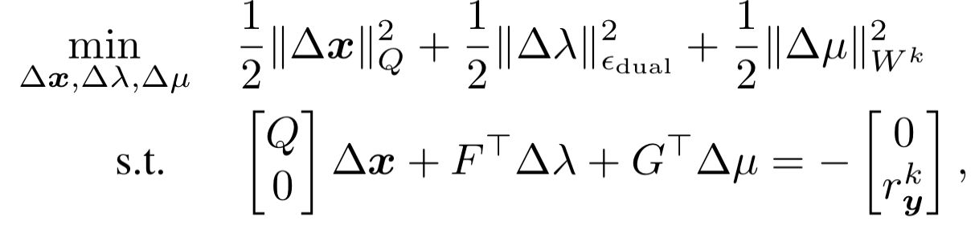
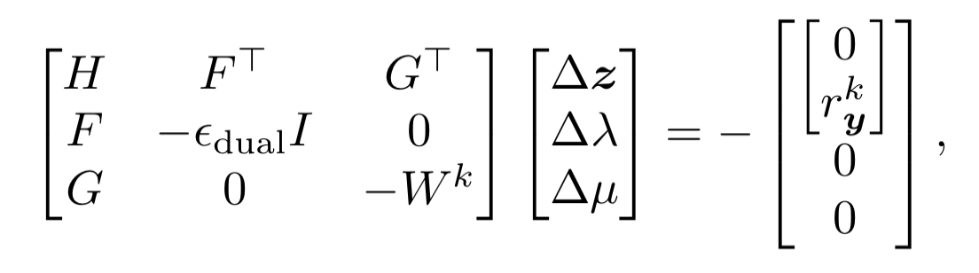
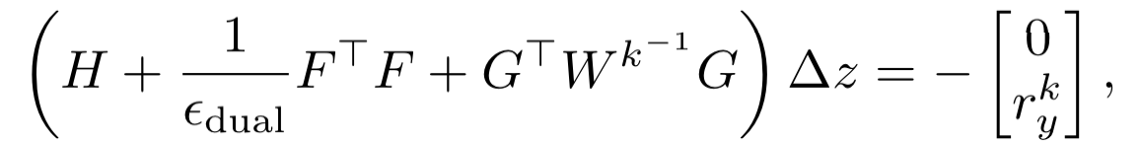
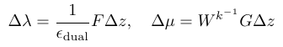

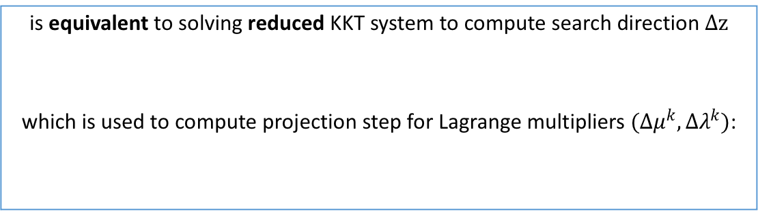
Infeasible IPM: Projection to Dual Feasibility (cont.)
Solve equality-constrained optimization problem to compute projection step
$$≡$$
is equivalent to solving KKT system to compute Newton-type search direction
Projection corresponds to IPM iteration with different right-hand side: obtain dual feasibility while maintaining optimality conditions
$$≡$$
is equivalent to solving reduced KKT system to compute search direction $Δz$
which is used to compute projection step for Lagrange multipliers $(Δμ^{k},Δλ^{k})$:
We can reuse the KKT matrix factorization between IPM iterations and projection steps for computational efficiency
Notes:
A derivation of the equivalence between the two equations can be found in our paper
due to the zero elements in the right-hand side of (13).
the projection step does not increase the residual value for the remaining optimality conditions
the projection (13) aims at retaining the IPM progress towards optimum

Slide 8
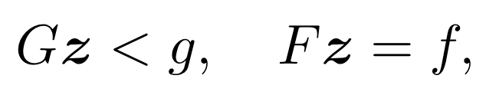
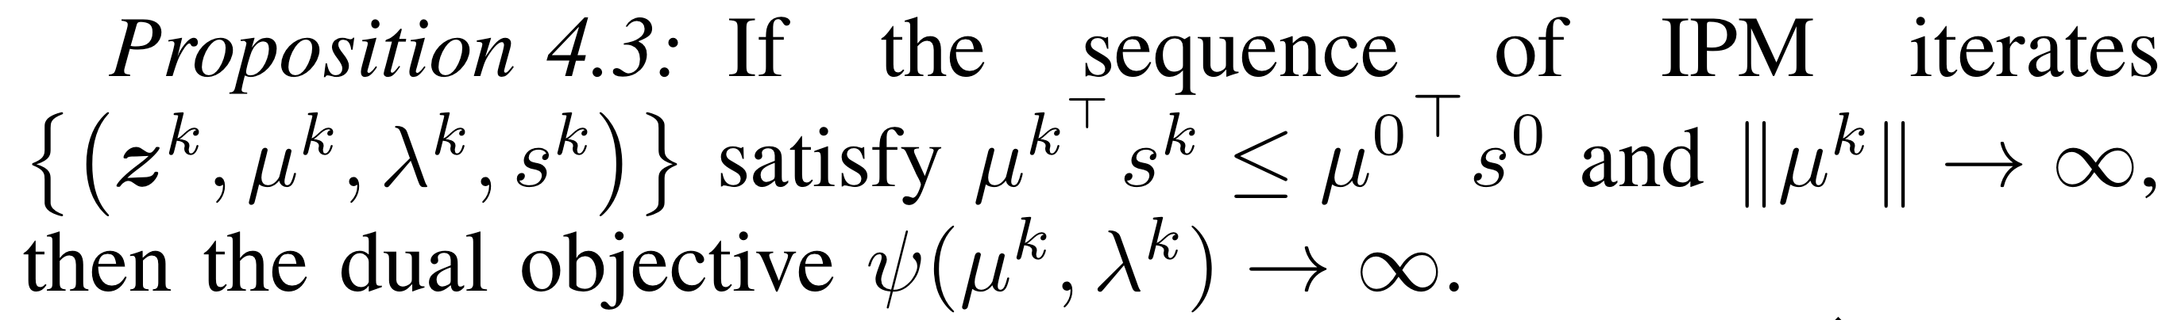
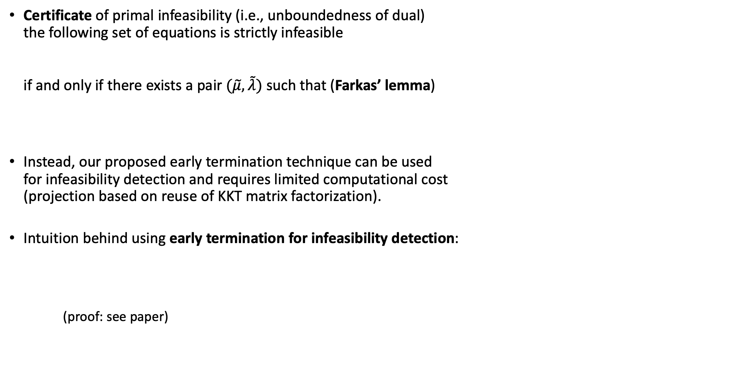
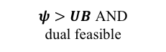

Early Termination of IPM: Infeasibility detection
Certificate of primal infeasibility (i.e., unboundedness of dual) the following set of equations is strictly infeasible if and only if there exists a pair $(\tilde{μ},\tilde{λ})$ such that (Farkas’ lemma)
Instead, our proposed early termination technique can be used for infeasibility detection and requires limited computational cost (projection based on reuse of KKT matrix factorization).
Intuition behind using early termination for infeasibility detection: (proof: see paper)
Compute dual feasible solution guess
Evaluate dual objective value $ψ$
Continue QP iterations …
No
$ψ>UB$ AND dual feasible
Yes
Early termination of convex QP solver
OR
Optimal objective value is larger than upper bound
No feasible solution exists to convex QP
Notes:
a Standard way to check the primal infeasibility is by using Farkas’ lemma,
check certificates of infeasibility is expensive, numerical results
Intuitively, since the dual objective is unbounded in case of primal infeasibility, we can terminate the solver whenever the dual objective of a dual feasible solution is “large enough".
We use the UB from the B&B optimization method as a threshold.
Prop. 4.3 shows that this intuition also holds for the IPM iterates.
Indeed, under mild assumptions, if the primal system is infeasible, then the dual objective of the iterates will be unbounded.
It may lead to termination before a certificate of infeasibility is found.

Slide 9

Early Termination of IPM: Algorithm Implementation
projection is not needed in every IPM iteration, we evaluate dual objective and perform projection only when early termination is likely
Notes:
Before we move onto the numerical simulation results, let's do a recap of the early termination strategy
Termination: dual obj>UB when dual feasible, by which we mean …
Note that projection is only performed when early termination is likely to happen, i.e., when dual obj>UB

Slide 10

Numerical Simulation: Real-Time Vehicle Decision Making
Notes:
This slide shows the numerical simulation of a real-time vehicle decision making problem
Blue rectangle is the vehicle we want to control
Red rectangles are the obstacles we want to avoid
15 blue dots are the positions of vehicle at the next 15 horizons, which is also the predicted trajectory
as we can see, the blue vehicle can successfully avoid the red obstacles by making lane changes, speeding up and slowing down.

Slide 11
Simulation Results: QP Calls and Total Iterations
QP calls and total iterations with and without early termination
Early termination reduces total number of QP iterations by 42%.
Notes:
This figure shows the numbers of QP calls and QP iters over the time horizons.
Subplot 2 shows that e.t. reduces the number of QP iters at every time horizon.
Subplot 3 illustrates this reduction in percentage.
Overall, in this particular numerical example, early termination reduces 42% of the total QP iterations.

Slide 12
Simulation Results: Early Terminated versus Fully Solved QPs
Early termination happens often, 36% of QPs are early terminated.
Early termination benefits from warm starting IPM.
Early termination takes less QP iterations.
Notes:
This figure shows the performance of early terminated QP versus those filly solved ones.
Subplot 1 shows that early termination of the IPM happens often. More specifically, about 36% of all QPs are early terminated in this particular example
In fact, the number of QP iterations is 0 at times 120−140 s, i.e., the warm start leads to immediate termination of the IPM
Comparing subplots 2 and 3, one can observe that early terminated QPs take considerably less iterations than fully solved QPs.

Slide 13

Simulation Results: Infeasibility Detection
Number of IPM Iterations for Certificate Versus
Early Termination With and Without Warm Starting
Early termination requires considerably less IPM iterations than the computation of a certificate of infeasibility.
Warm starting can reduce the number of IPM iterations further and it can lead to immediate termination, i.e., termination at 0 iterations.
Notes:
Now let's see how effective early termination is for infeasibility detection.
this table presents the number of IPM iterations for the three approaches to detect the three infeasible QPs from the MI-MPC example.
Table shows that early termination requires considerably less IPM iterations than the computation of a certificate of infeasibility, which is the Farkas' lemma.
Note that early termination does not distinguish between a case of primal infeasibility or a case where the objective value exceeds the current UB.
In addition, Table I shows that warm starting can reduce the number of IPM iterations further and it can lead to immediate termination, without the need to perform any IPM iterations.

Slide 14
Conclusions
An efficient early termination strategy based on a projection step tailored to IPMs, in order to reduce the computational cost within B&B method in solving MI-MPC.
Early termination of QP solvers in MI-MPC works well in
terminating QPs whose objective value > UB;
detecting infeasible QPs.
Early termination is performed by using Newton-type IPM iterations
reuses KKT matrix factorizations for computational efficiency;
intuitively guarantees the inequality constraint, i.e., positivity in 𝜇;
projection also makes progress towards convergence.
Thank you!
Notes:
We finally make so conclusions of our work.
We proposed an efficient early termination strategy based on a projection step tailored to IPMs, in order to reduce the computational cost within the B&B method in solving MI-MPC problems.
In addition, we proved that our early termination strategy can be effective for infeasibility detection and often it terminates the IPM before a certificate of infeasibility is found.

